Slide 1
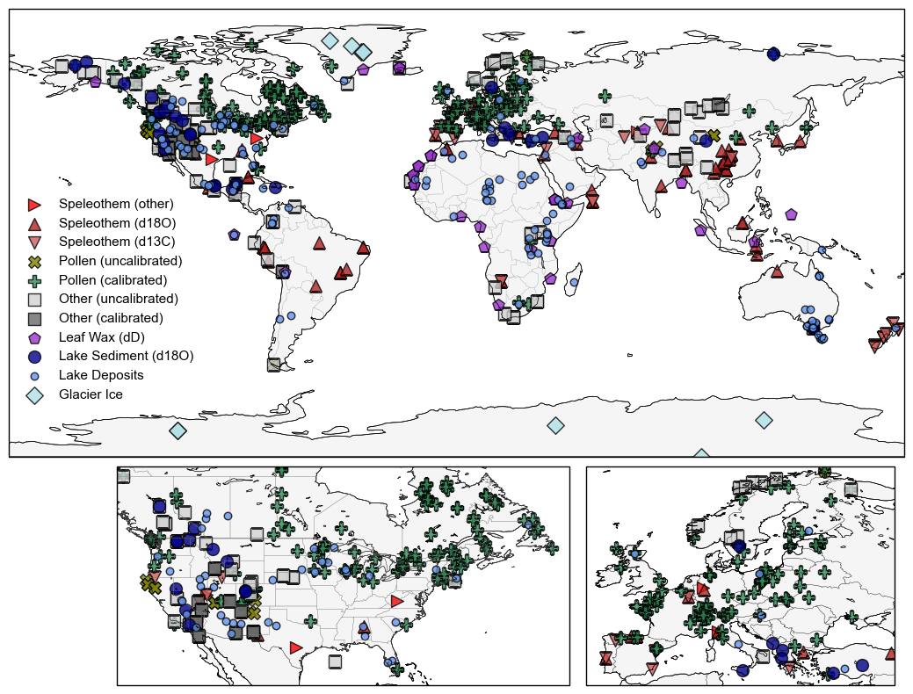
Figure 1: proxies/archives categories
Notes:
Need to talk with cody about revising categories and match symbology with wNA
Add (n=) to legend

Slide 2
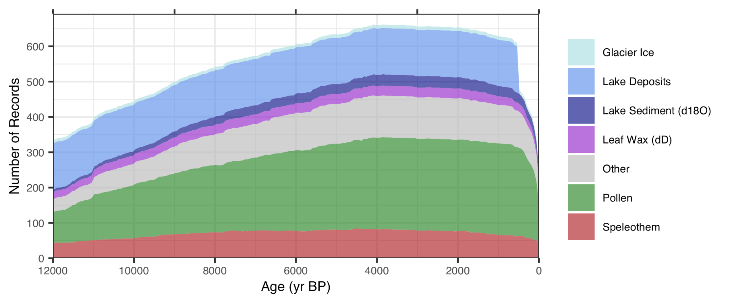
Figure 2: # of records over time
Notes:
Match colors with those on map.
Maybe add (resolution = x-years) tp legend

Slide 3
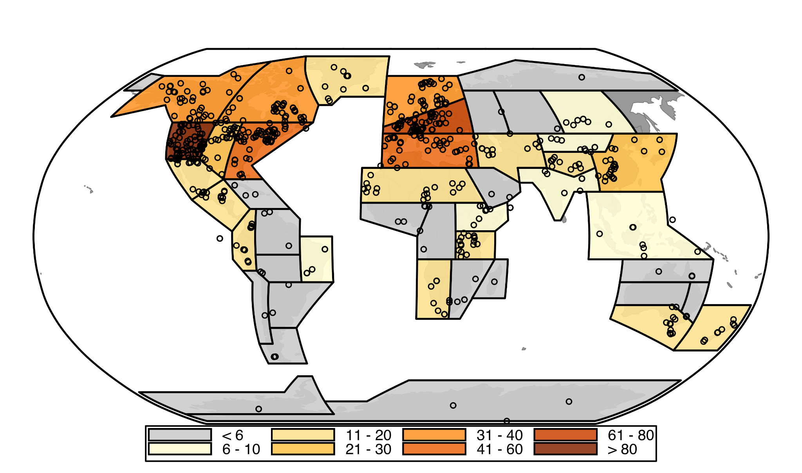
Figure 3: # IPCC regions and Proxy Data
Notes:
(Symbol = 6ka-0ka)?
Advantages:
don’t change when adding/removing data
Temperature and Hydroclimate regions can be the same
Script can flow smoothly in python without having to switch to device with ArcGIS pro
2) Less arbitrary / no parameters I select
3) translate to other research

Slide 4
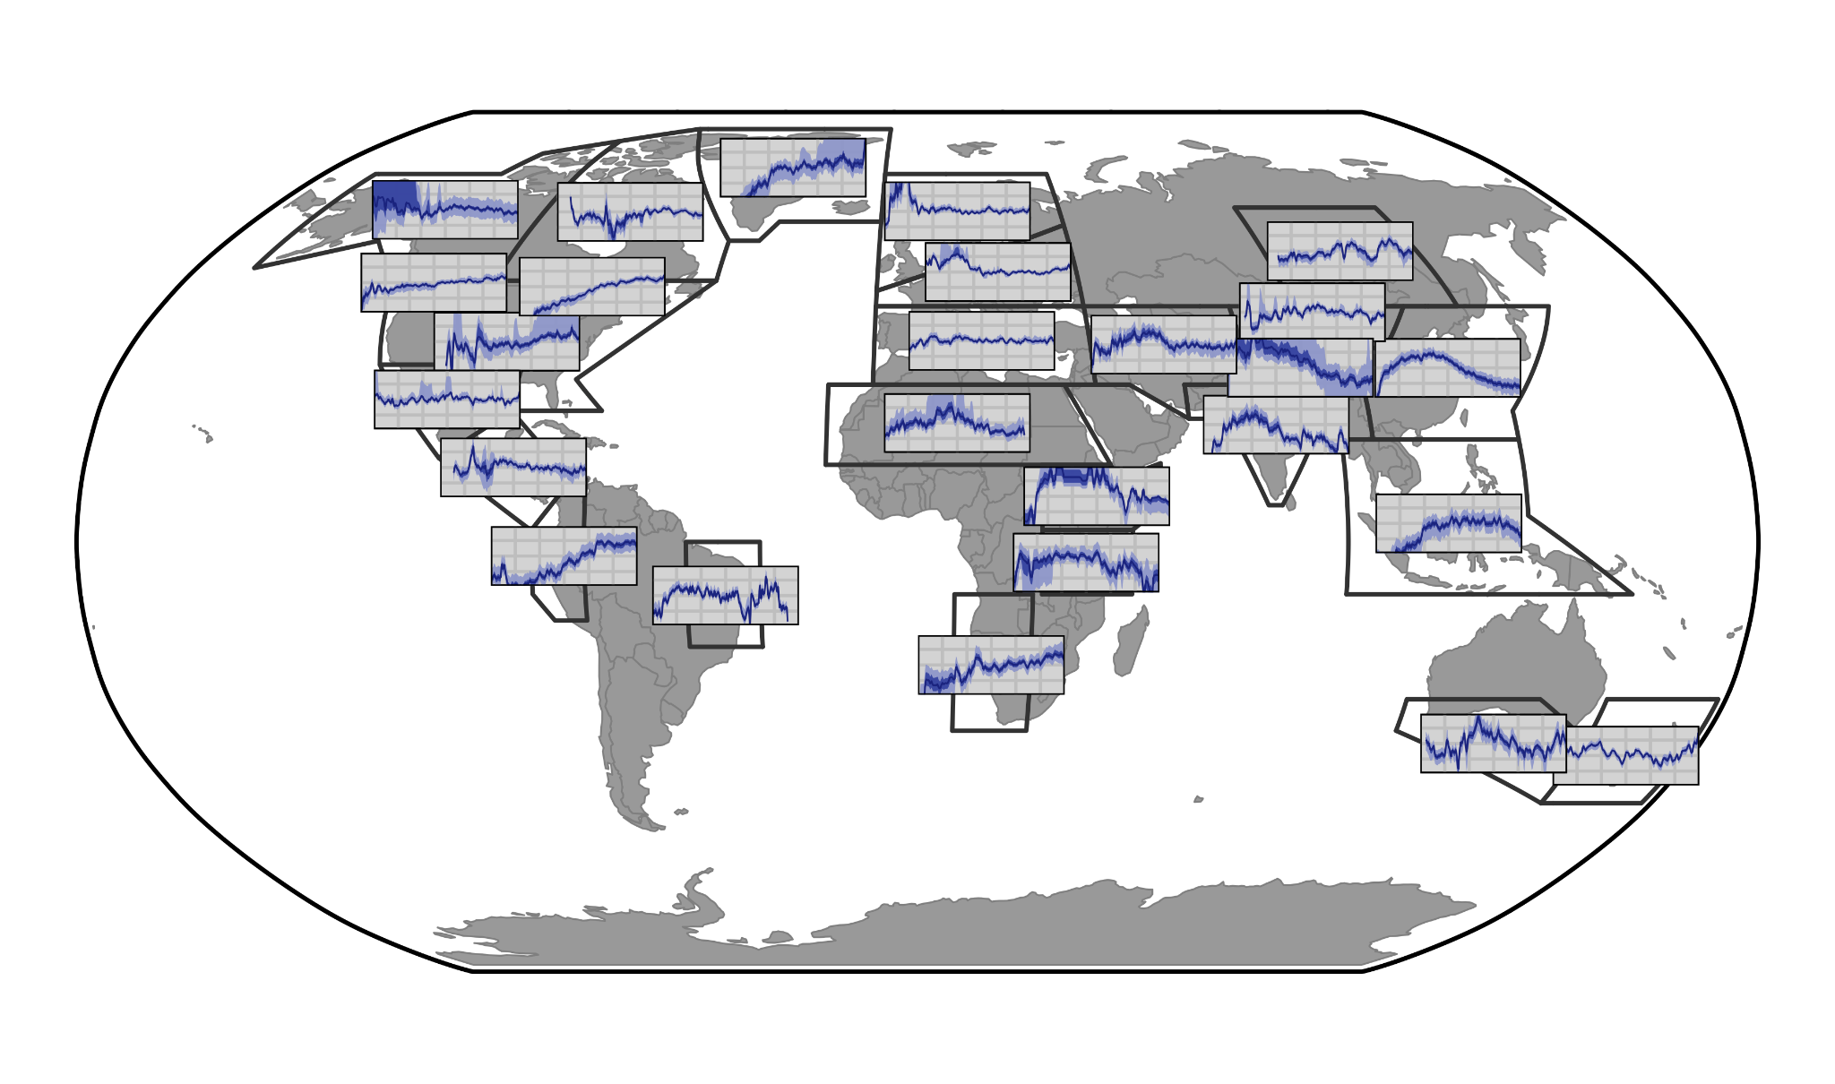

Slide 5
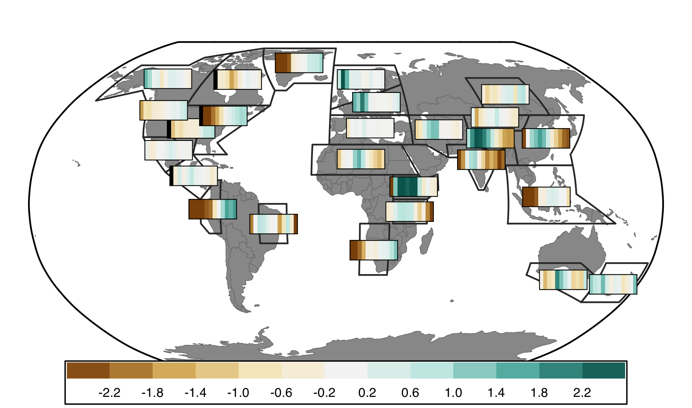

Slide 6
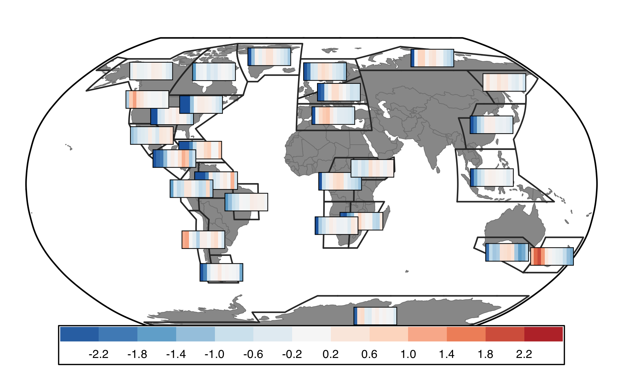

Slide 9
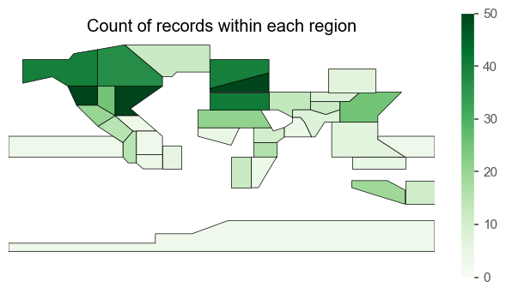
Or could use IPCC

Slide 10
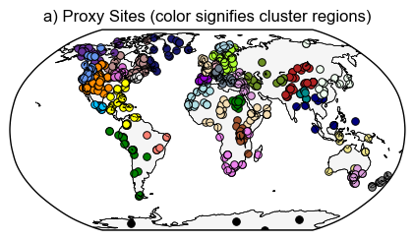
Figure 3: Cluster results
Notes:
R2 values: check from arcgis output

Slide 11
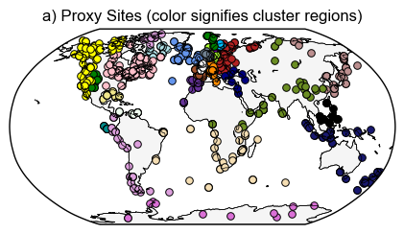
temperature
Notes:
Colors based on HC cluster # so will change to better distinguish neighboring clusters (pacific South America and Antarctica / 2 in Australasia)

Slide 12
Notes:
(Min of 3)

Slide 13
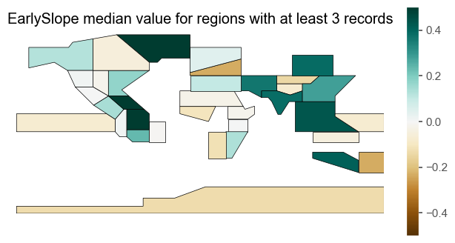
Notes:
(Min of 3)

Slide 14
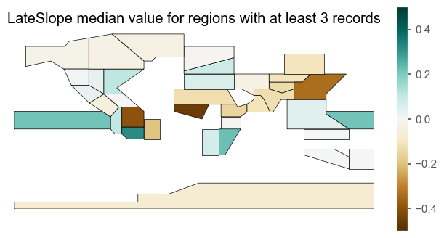
Notes:
(Min of 3)

Slide 15
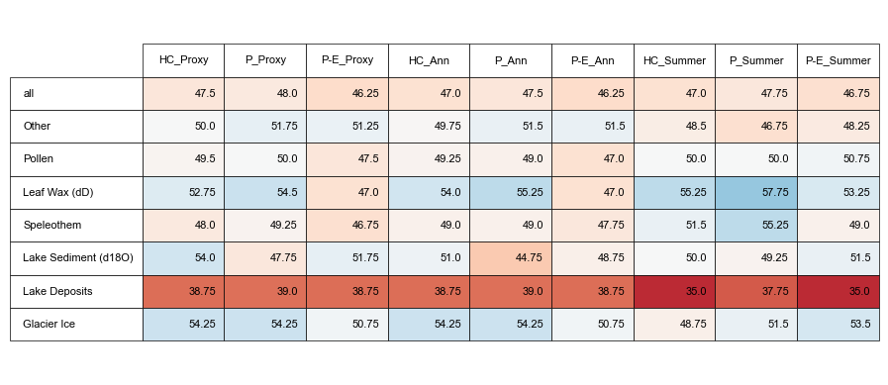
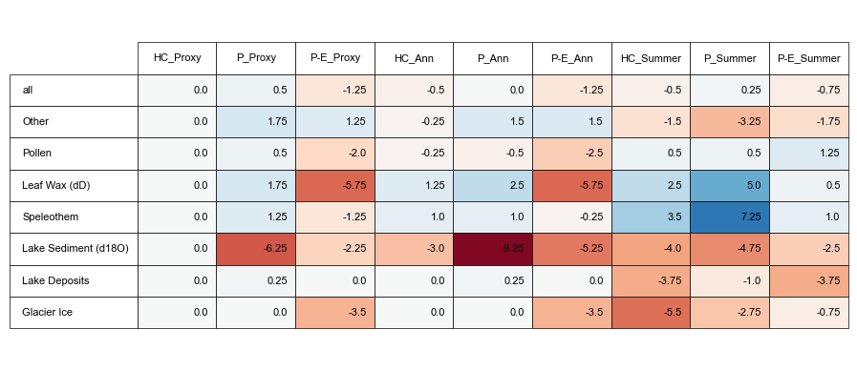
Notes:
Comparisons of how proxies (hydroclimate) compare with model pseudoproxies based on various assumptions about proxy climate interpretation (proxy metadata vs all P vs all P-E) and seasonality (proxy metadata vs assume annual are summer vs assume all are summer)
Top: Absolute %
Bottom: Difference between assumption test and using proxy metadata for both assumptions (1st column)

Slide 16
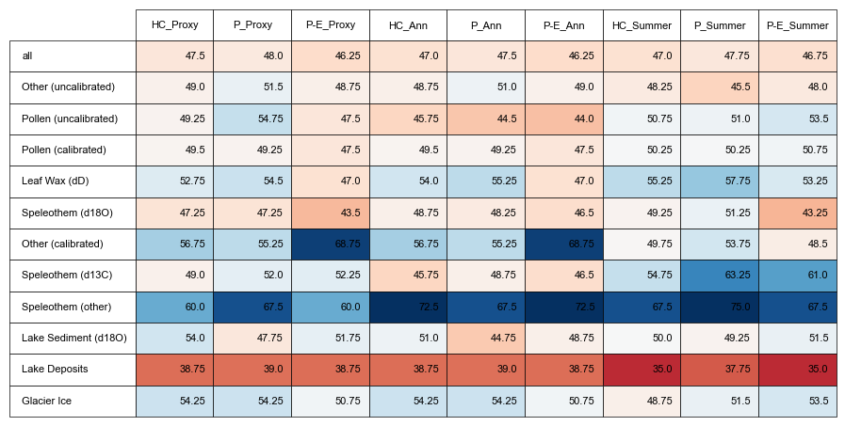

Slide 17
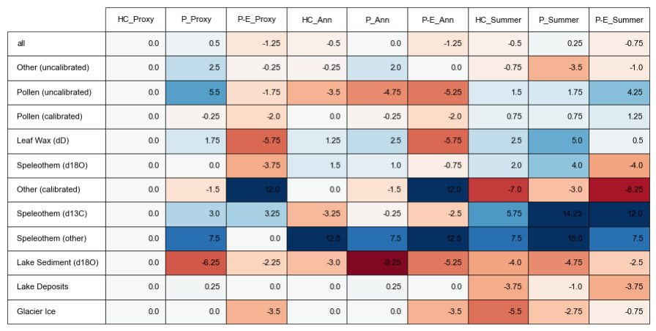

Slide 18
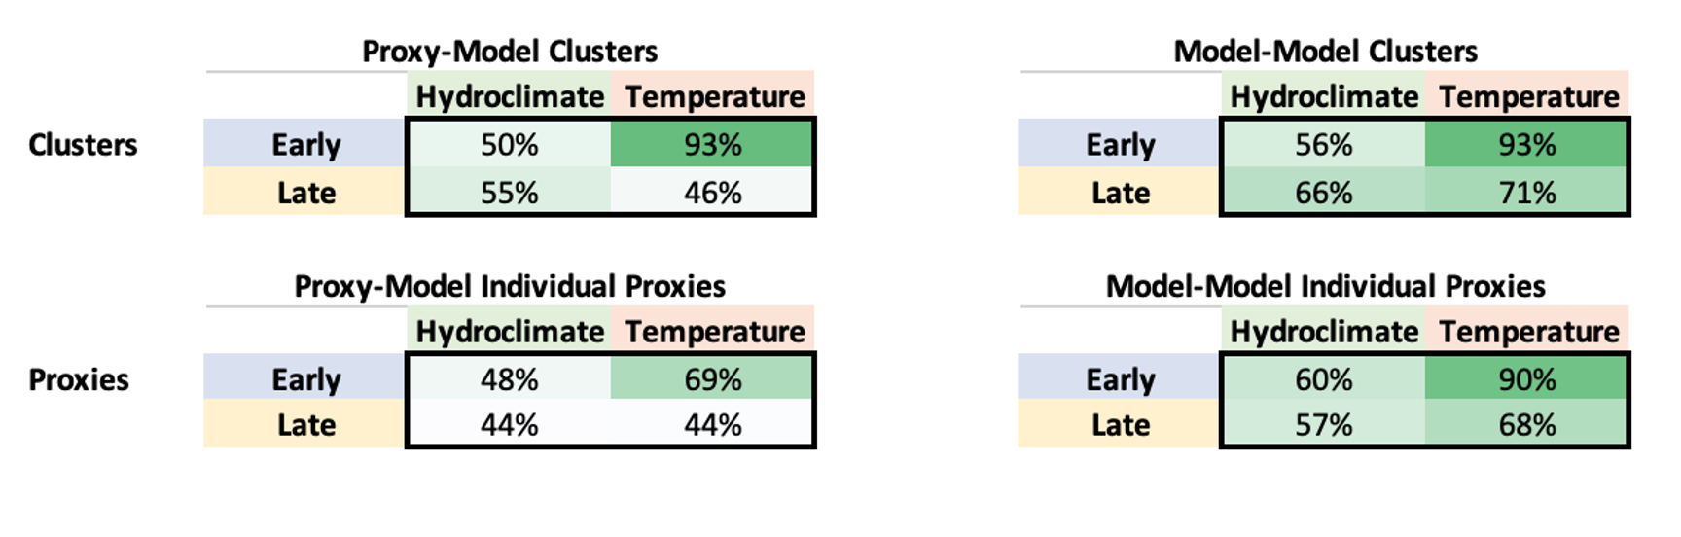

Slide 19
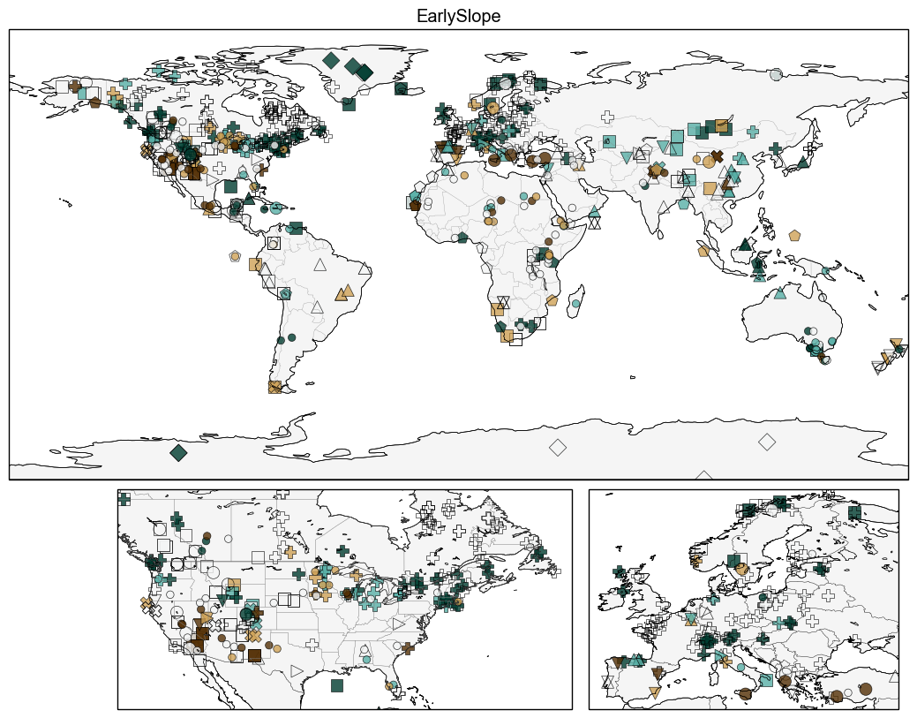
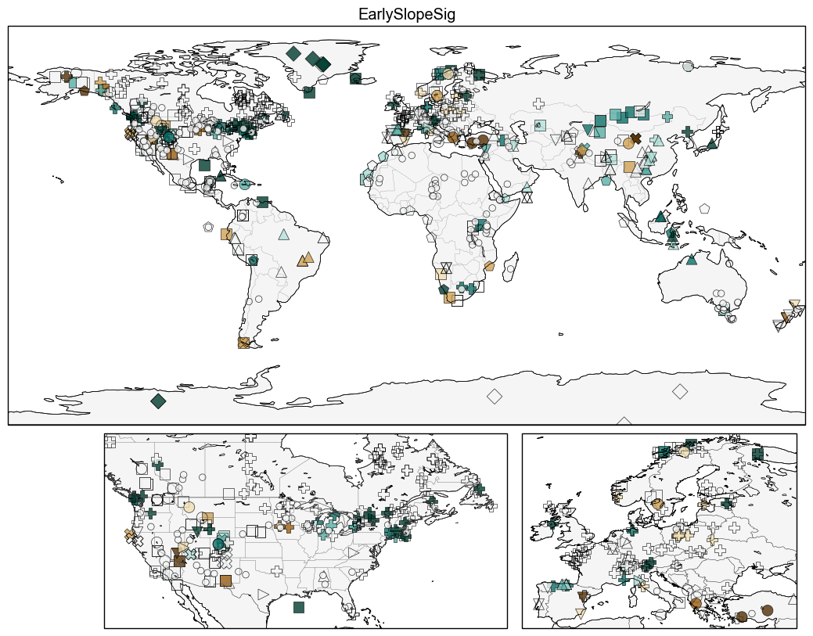

Slide 20
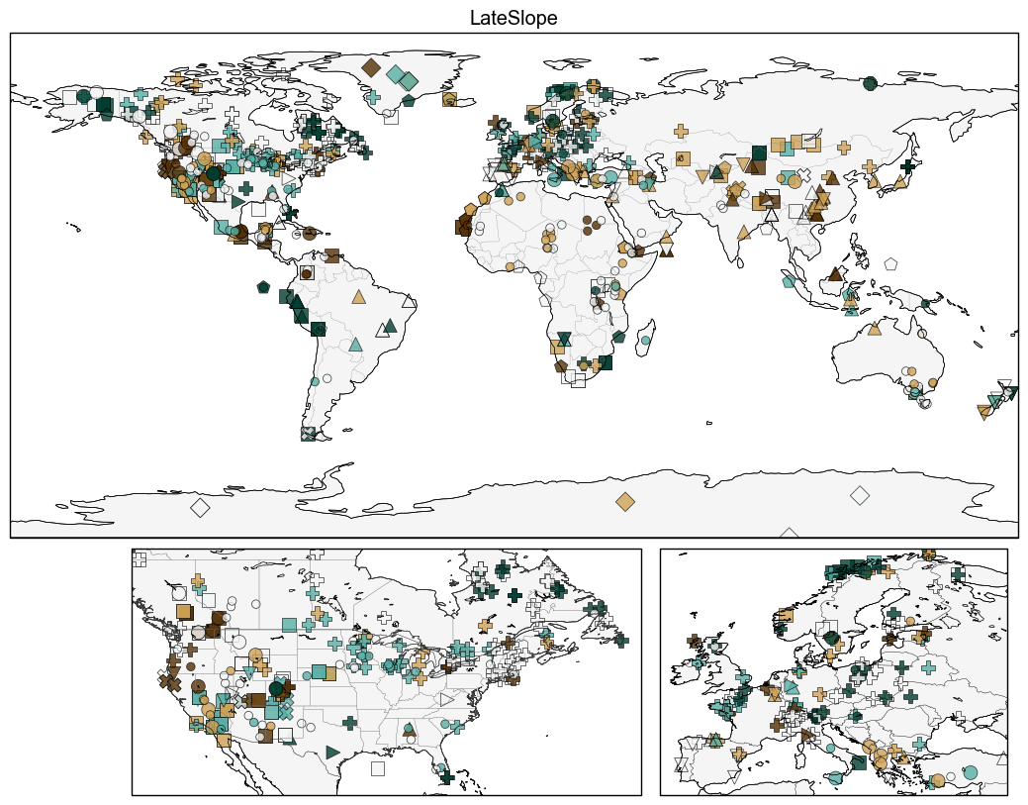
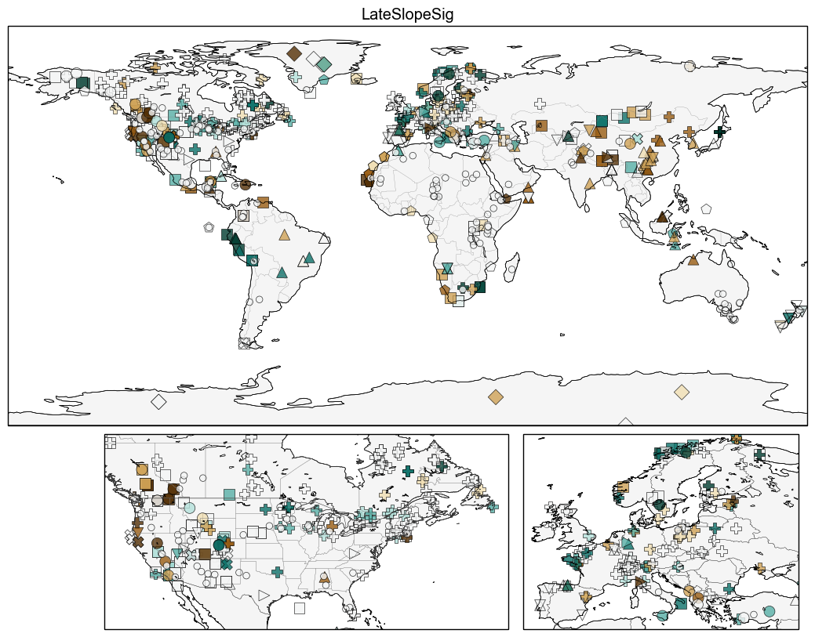

Slide 21
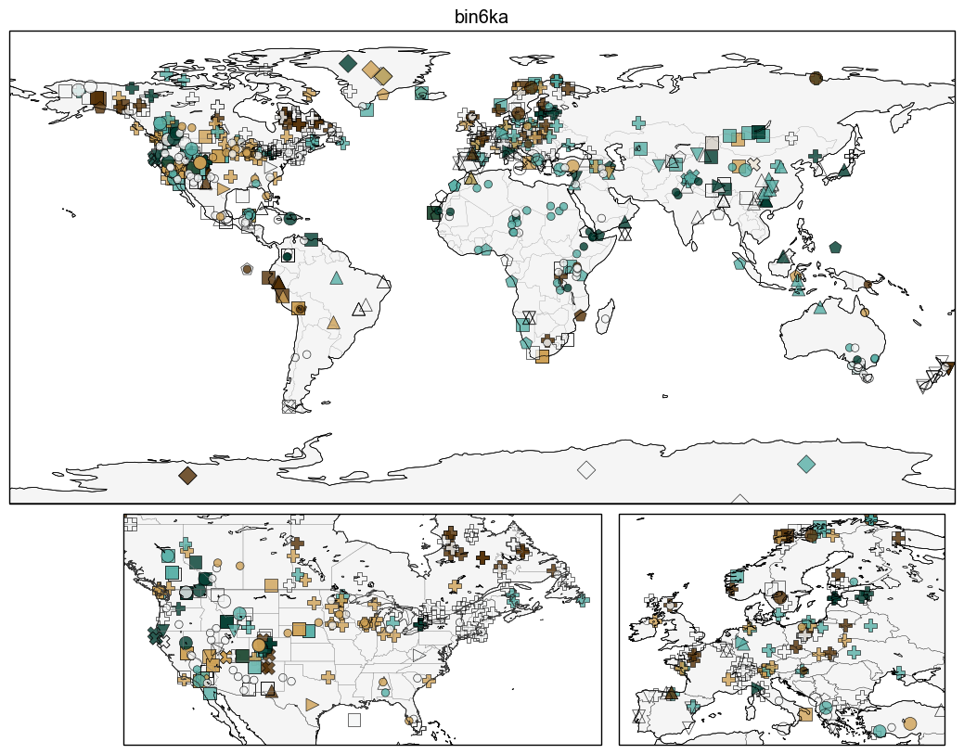

Slide 22
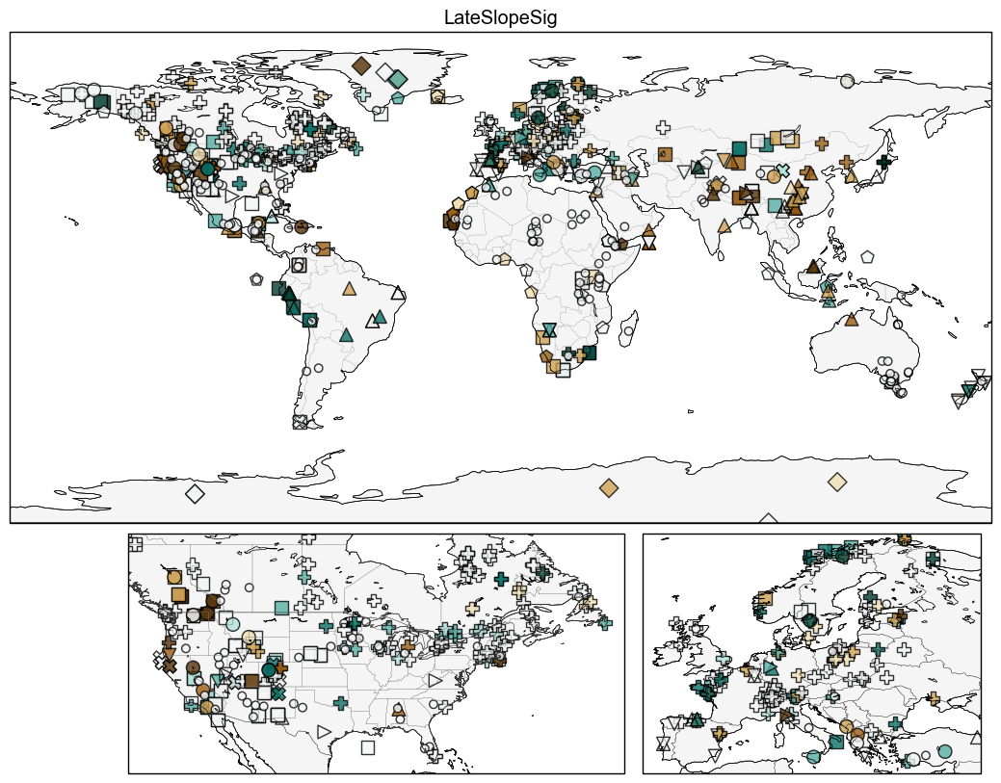

Slide 24
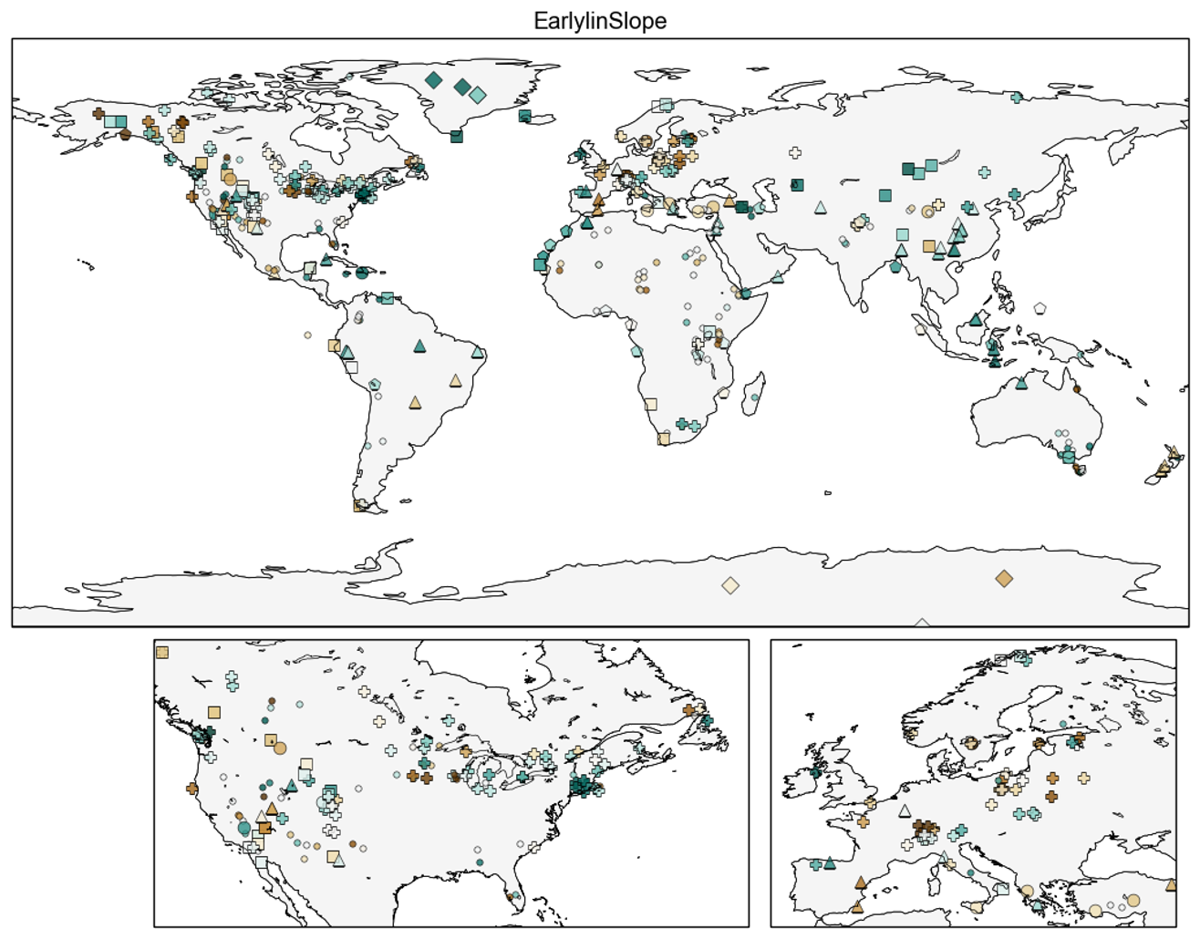

Slide 25
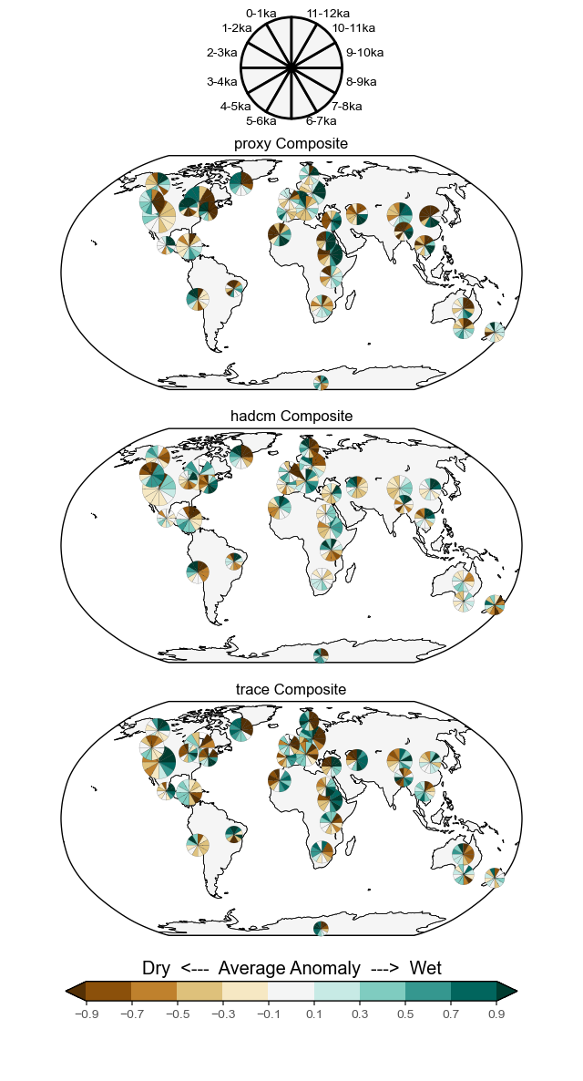
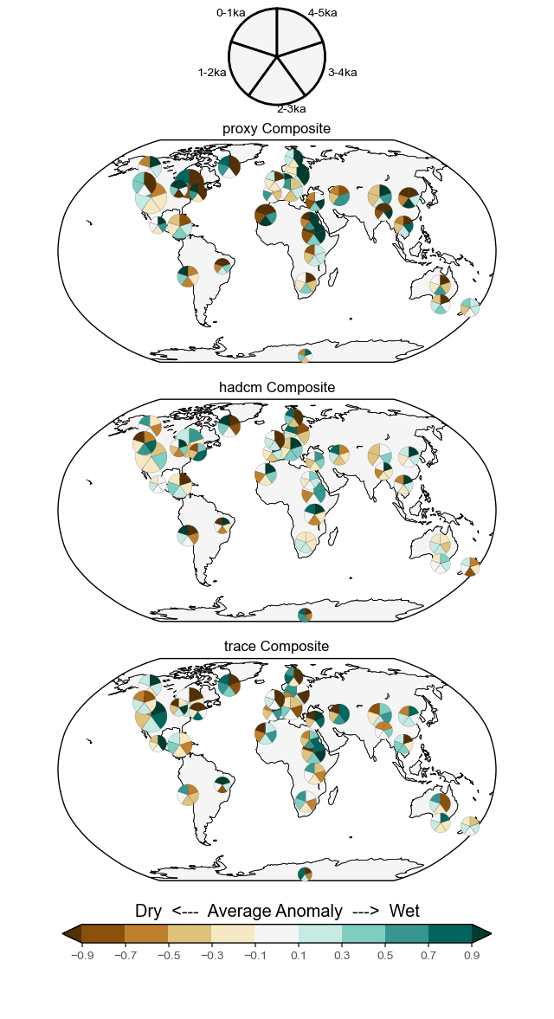

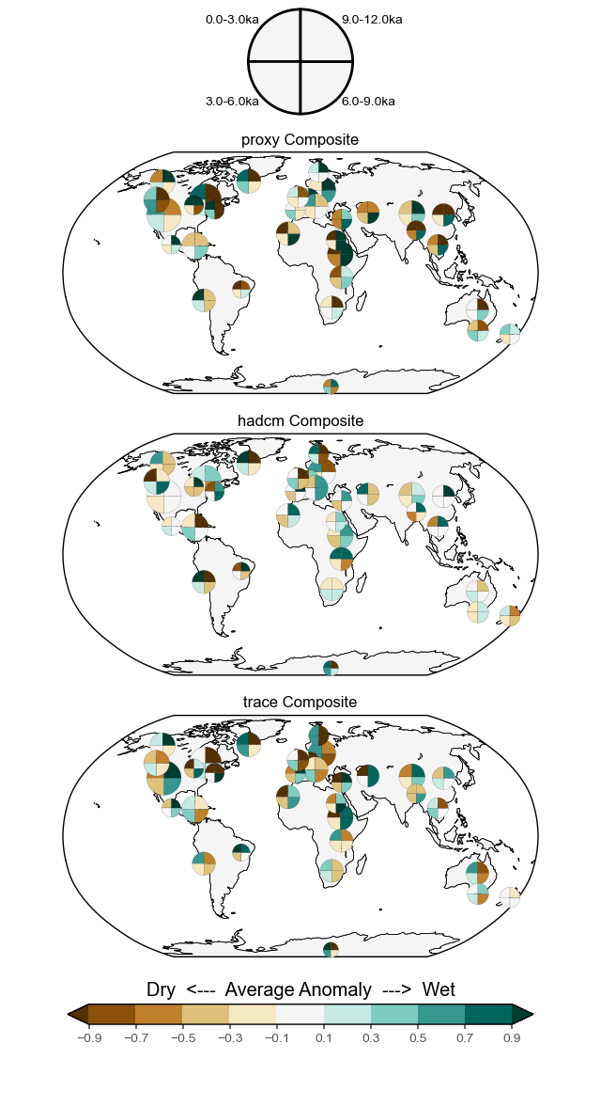

Notes:
Mean value for each timebin. Timeseries standardized over entire Holocene.

Slide 26
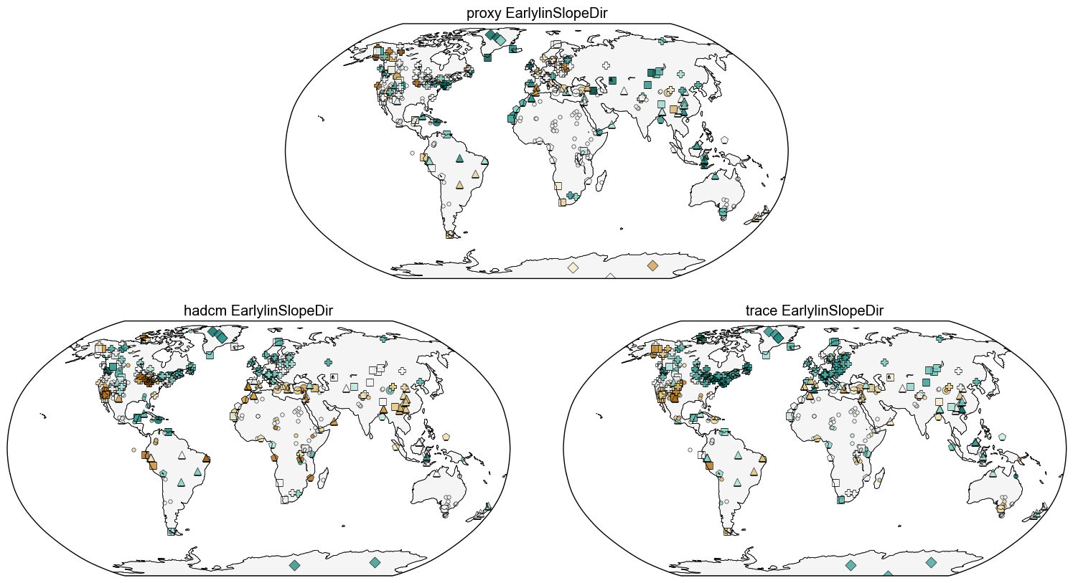

Slide 27
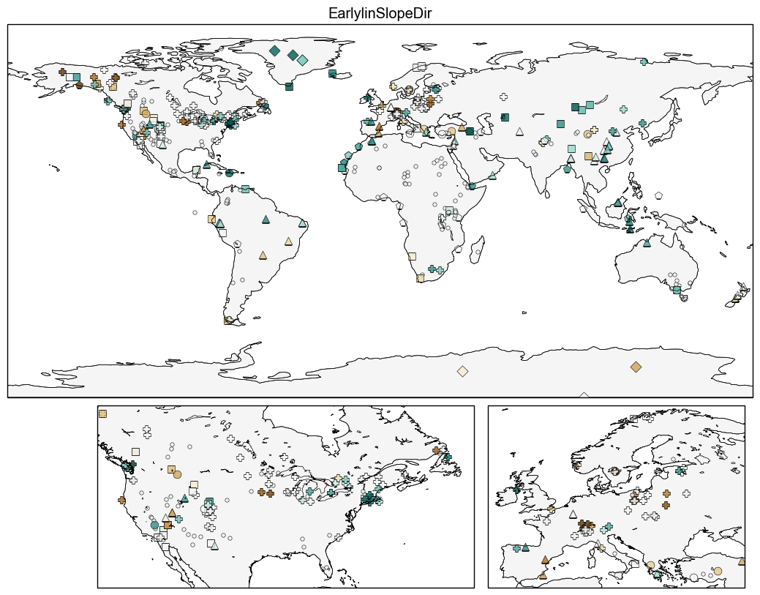

Slide 28
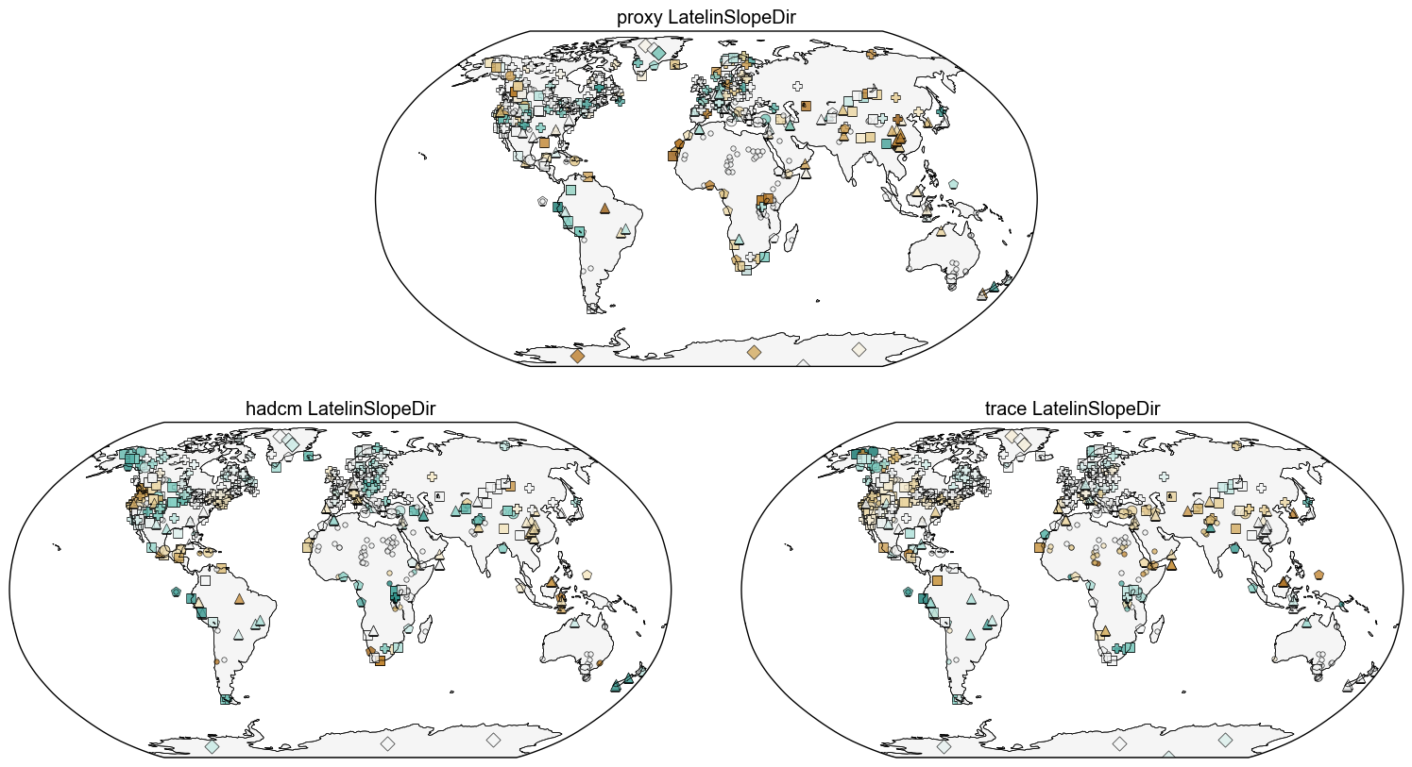

Slide 29
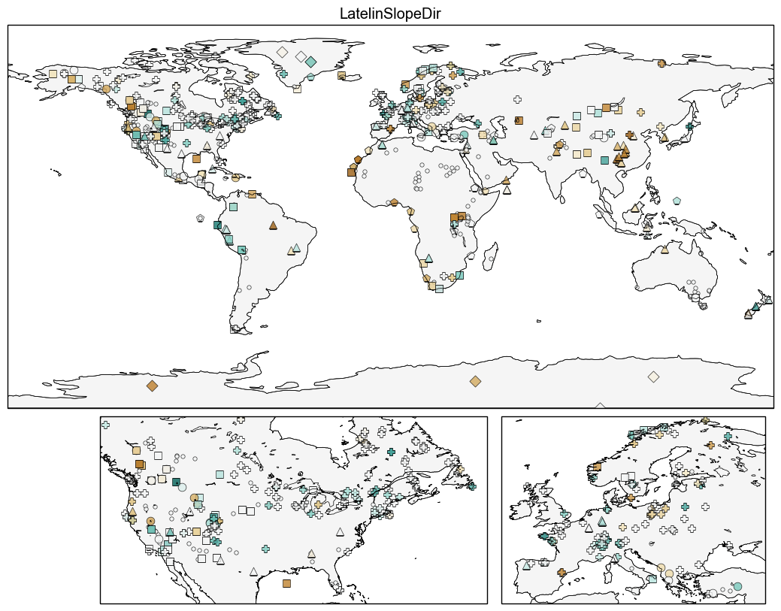

Slide 30
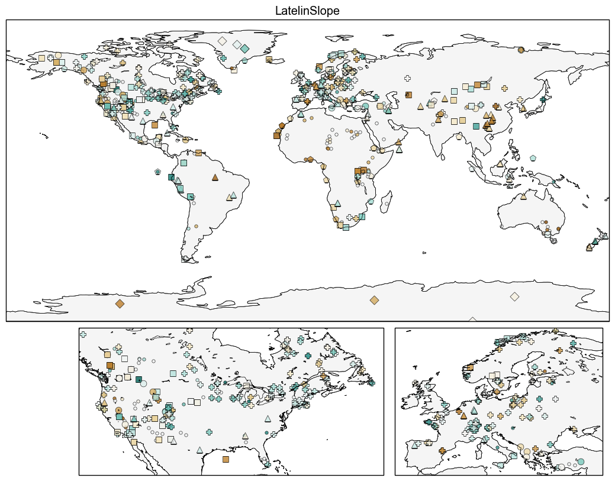

Slide 31
